Slide 1
caDSR 3.0 Sentinel Tool
Presented November 17, 2004

Slide 2
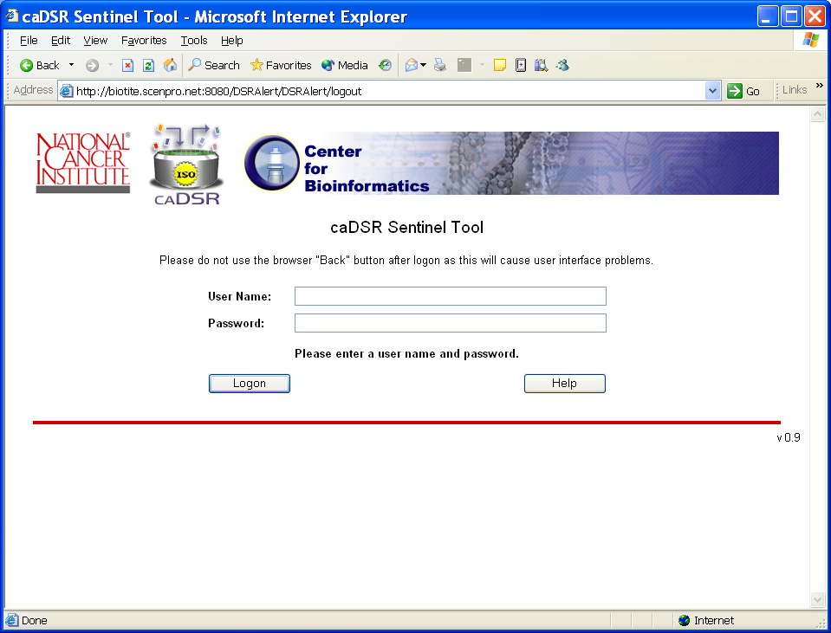
Logon

Slide 3
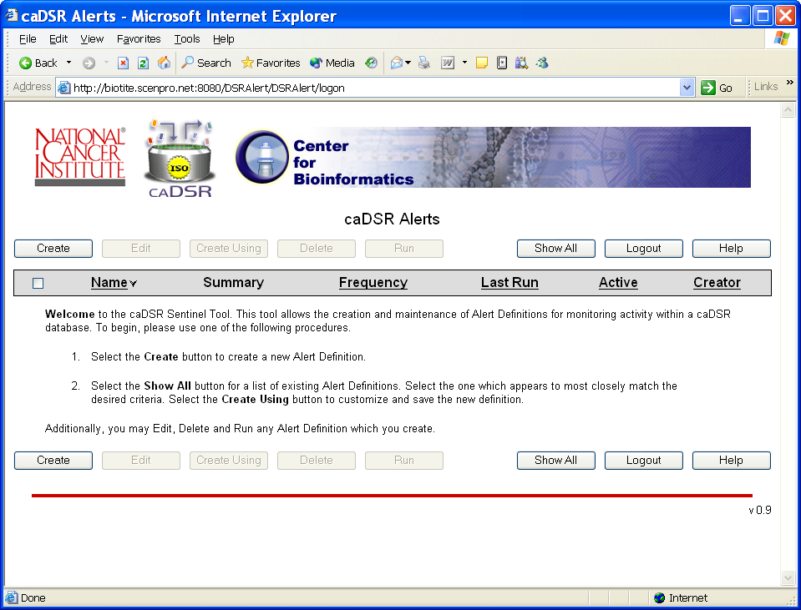
Intro for First Time User
A First Time User will see this introduction message on the List Screen.

Slide 4
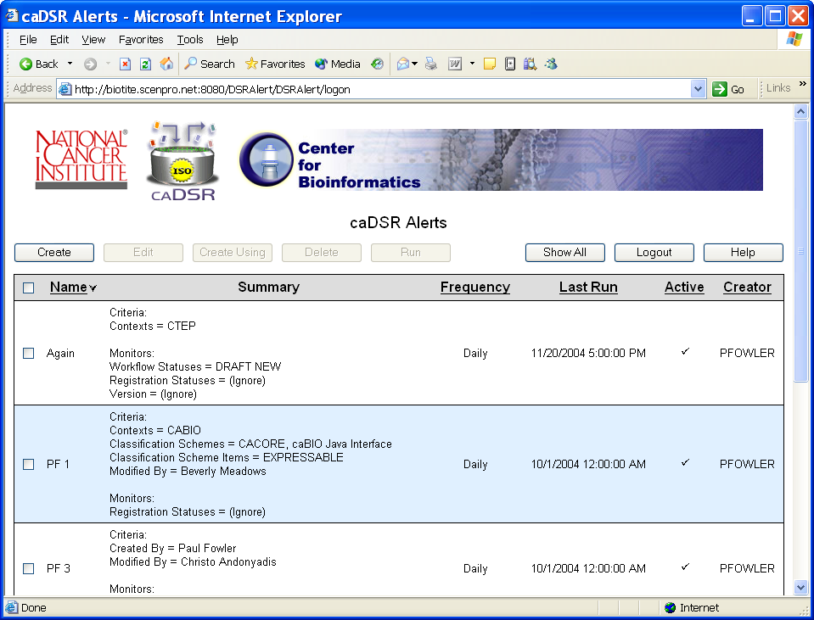
Returning User
Returning Users will first see the private list of Alerts. Use “Show All” to see all Alert Definitions.

Slide 5
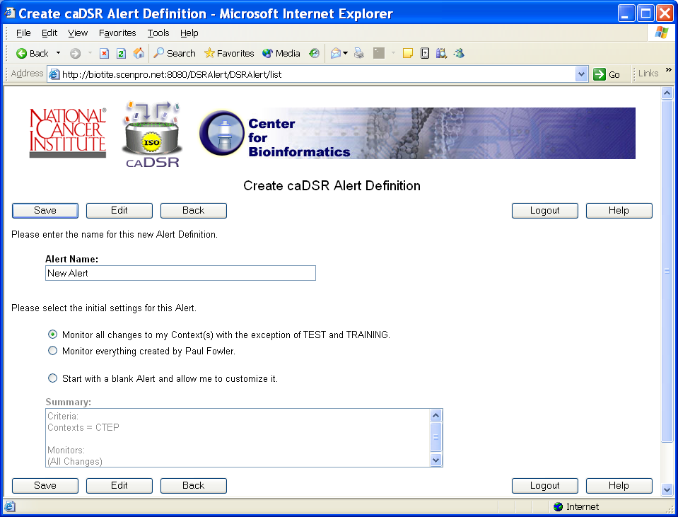
Create a New Alert
Initial Creation of an Alert uses programmatic defaults so you are only prompted for basic information.

Slide 6
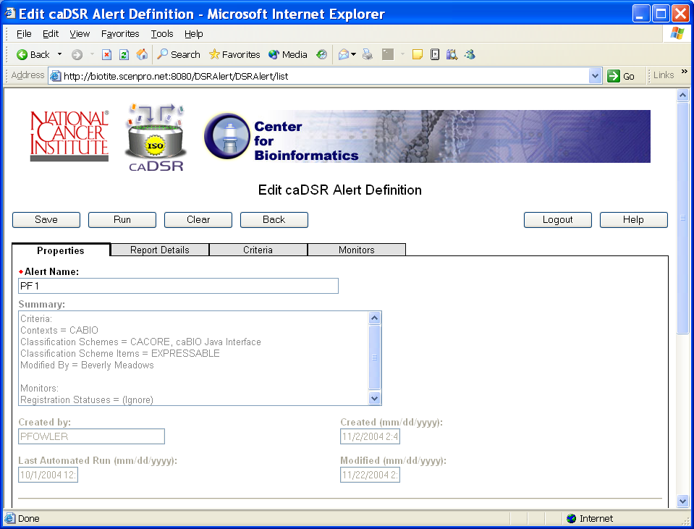
Edit - Properties Tab
The Edit screens give access to the full Alert definition. Information is divided into 4 tab pages.

Slide 7
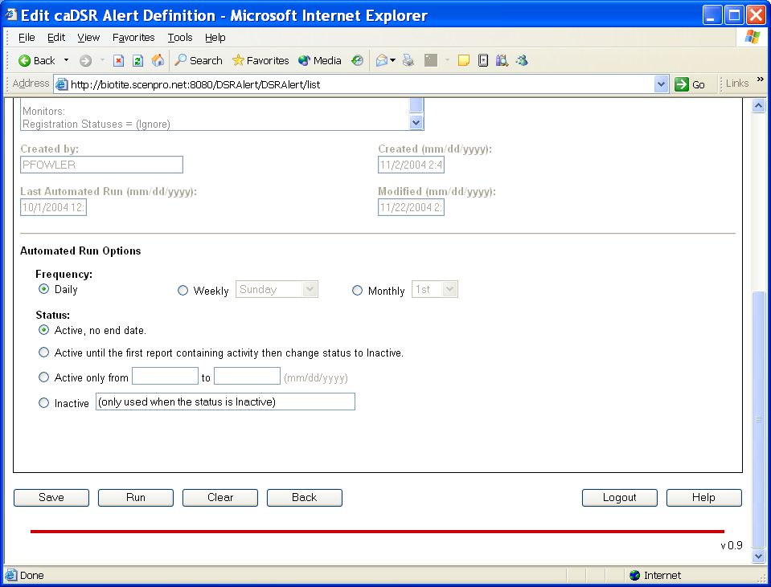
Edit – Properties Tab
For convenience the buttons are always repeated at the bottom of the screen.

Slide 8
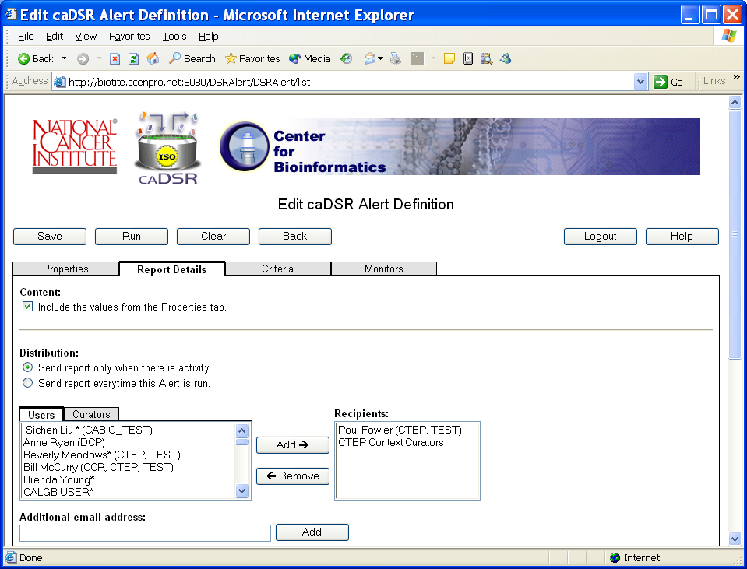
Edit – Report Details
The tab controls are a combination of HTML and Javascript which keeps the page light weight.

Slide 9
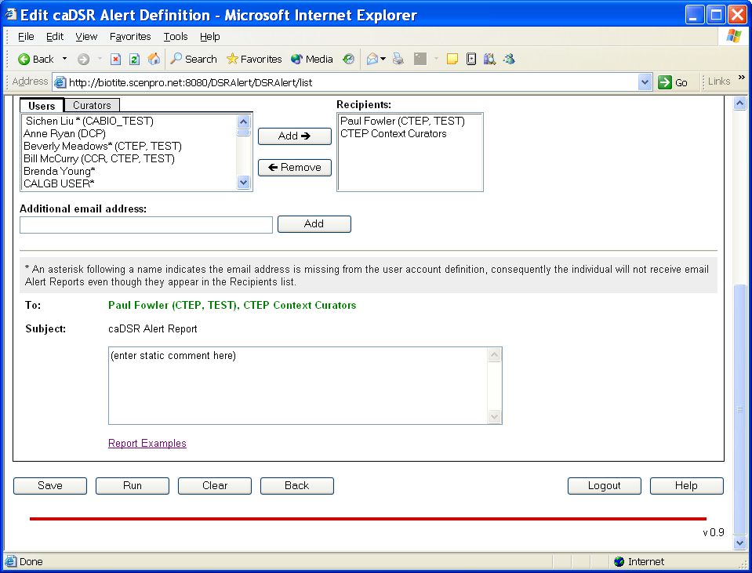
Edit – Report Details
The red line always shows the end of the page. You can stop reading here.

Slide 10
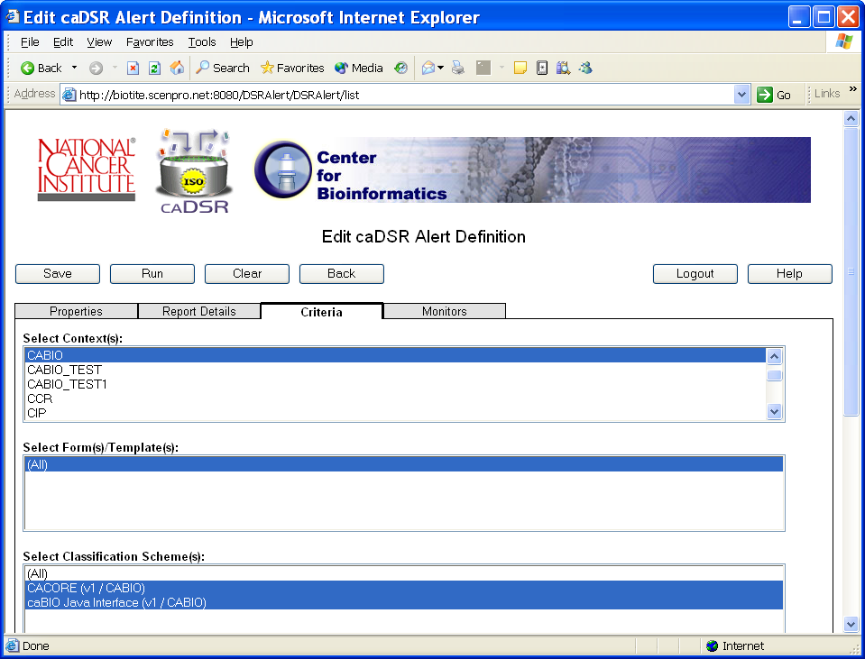
Edit - Criteria
For consistency Logout and Help always appear in the same place on all screens.

Slide 11
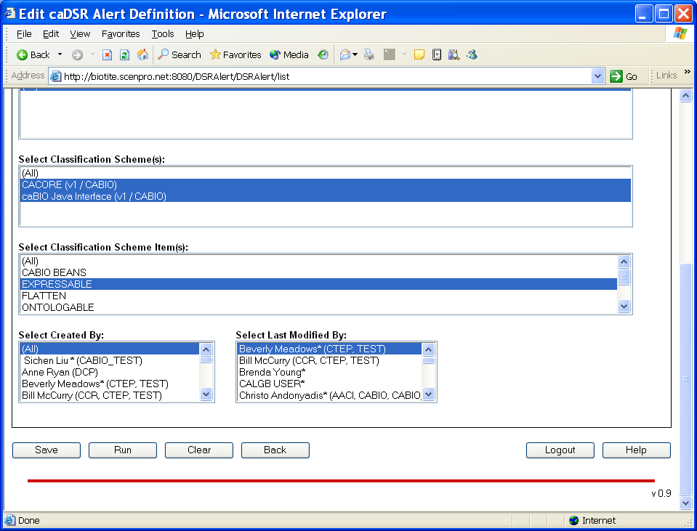
Edit - Criteria
The “v” number in the lower right corner is the Sentinel Tool Version Number.

Slide 12
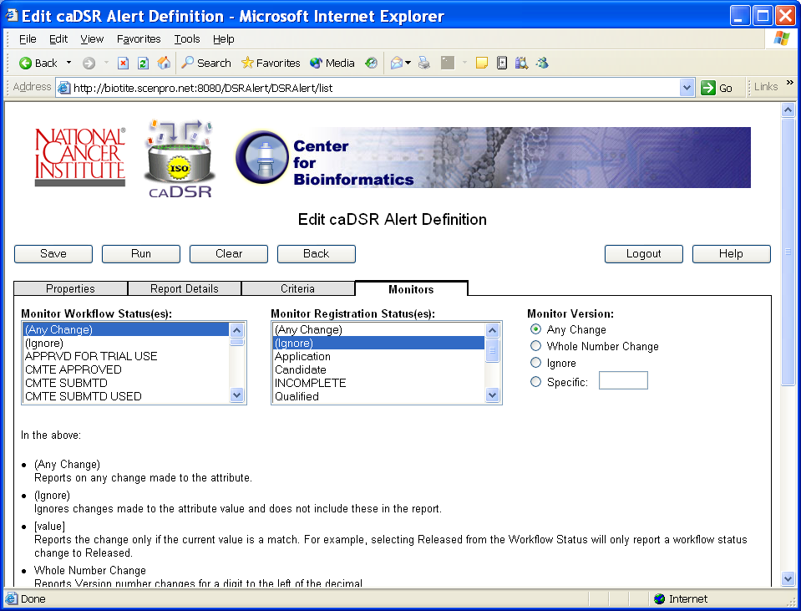
Edit - Monitors
Save writes an Alert
Run manually executes
Clear restores from the database
Back returns to the previous screen

Slide 13
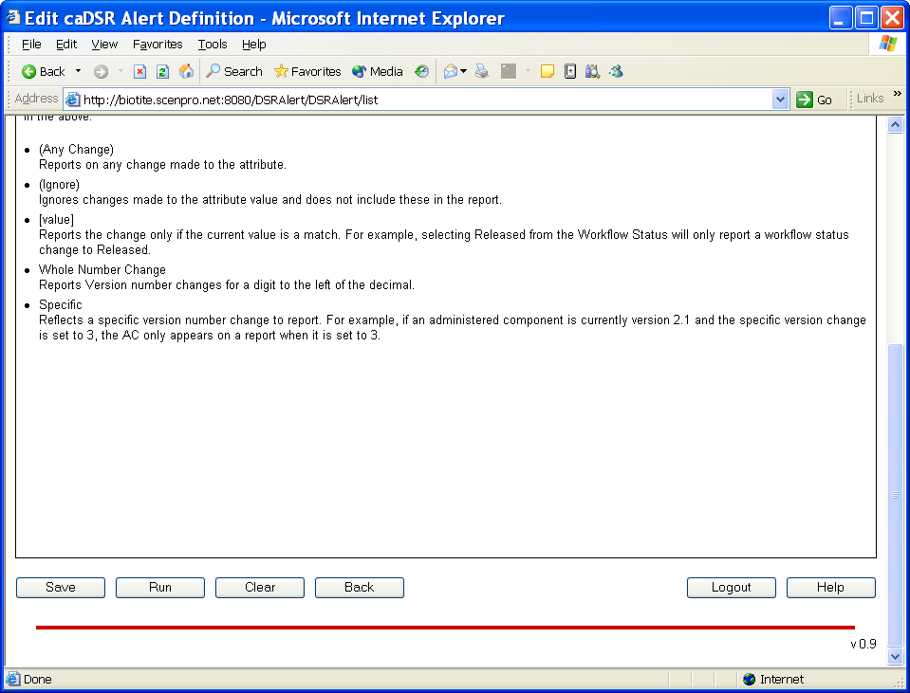
Edit - Monitors
Where space permits key reminders and help is provided.

Slide 14
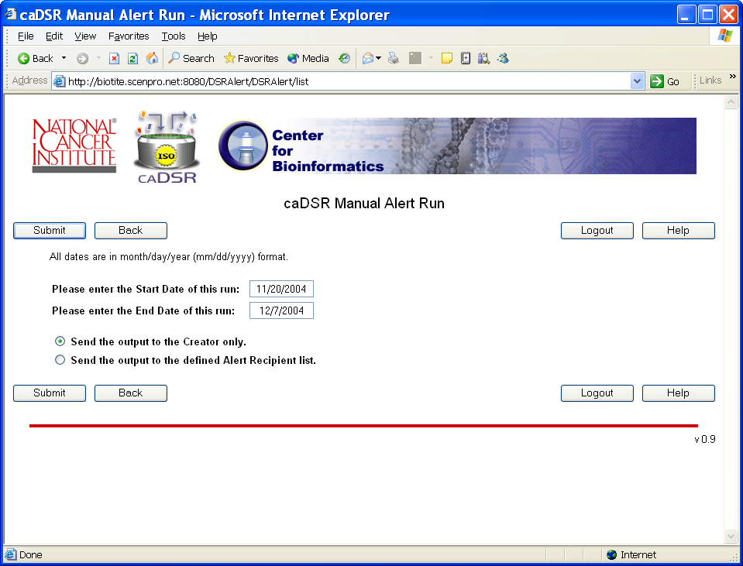
Manual Run
An Alert can be manually executed or wait for the automated daily run.

